Slide 1
The Intrapsychic Model from
Virginia Satir
Sharon Rooke
Satir psychotherapist
Ukcp reg psychotherapist
Nlptca acc. Psychotherapist & Supervisor

Slide 2
Five Freedoms
The freedom to see and hear what is here
Instead of what should be, what was, or what will be
The freedom to say what one feels and thinks
Instead of what one should feel and think
The freedom to feel what one feels
Instead of what one ought to feel
The freedom to ask for what one wants
Instead of having to always wait for permission
The freedom to take risks, on one’s own behalf
Instead of choosing to be only ‘secure’ and not rocking the boat

Slide 3
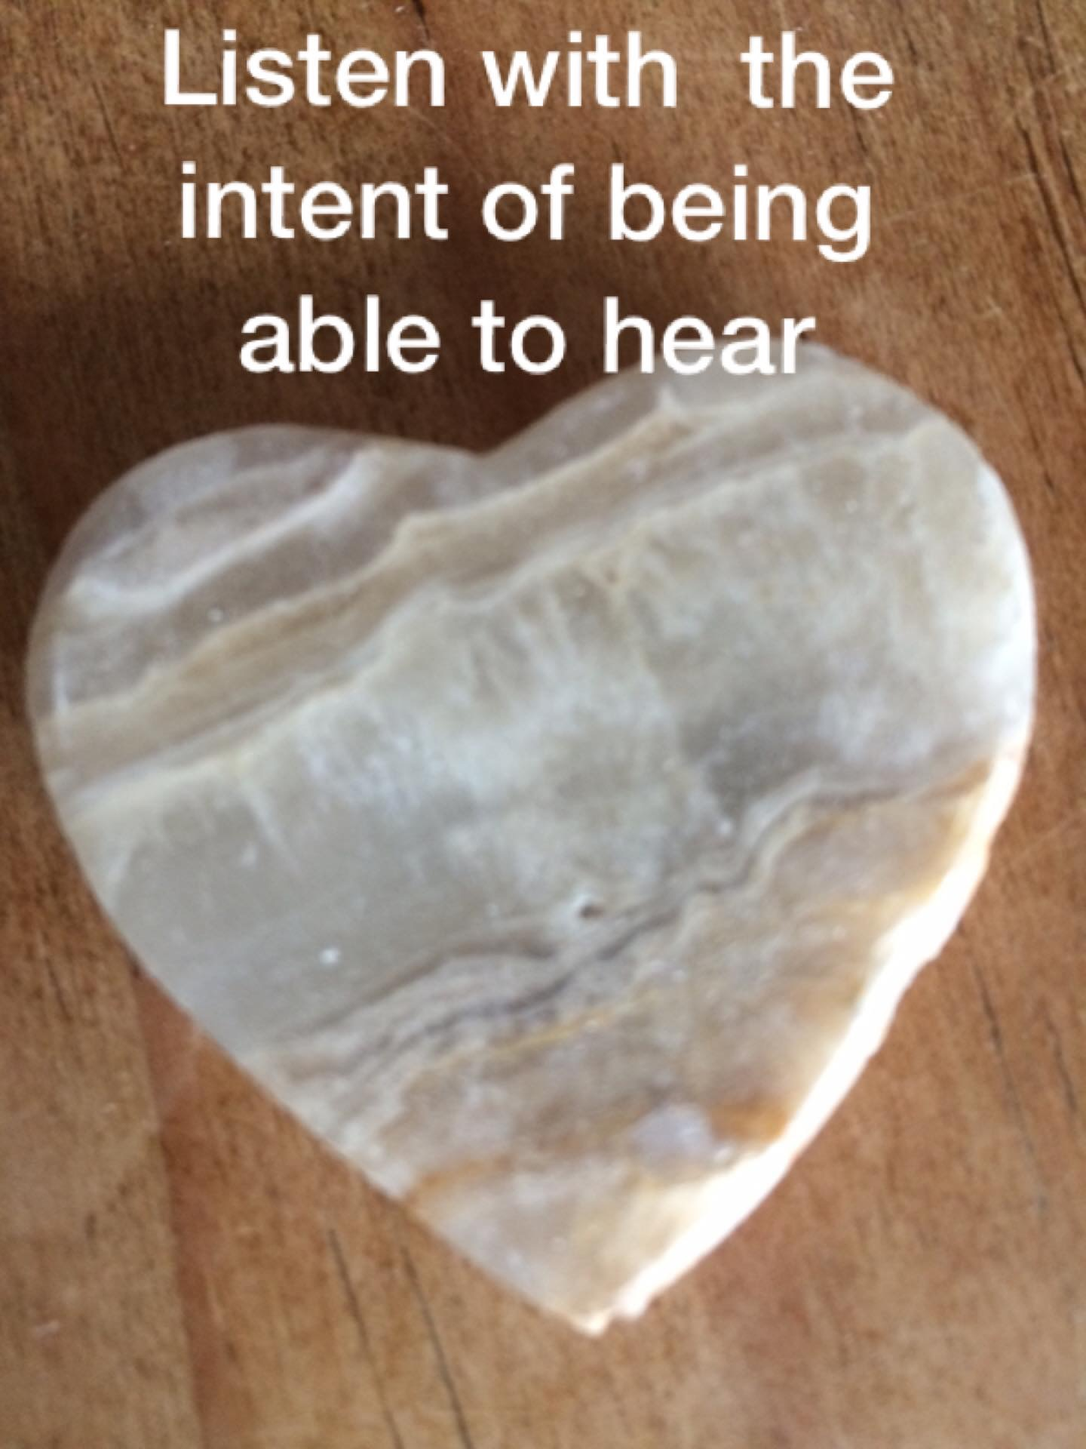
Significant Emotional Events
Birth/Death
Marriage/Divorce
Health/Illness
Promotion/Getting Fired
Exams/Tests etc…etc…etc..

Slide 4

Life Force
Geared for Survival
Meaning Making Mammals
Rules Rule
Impact
Life Energy

Slide 6
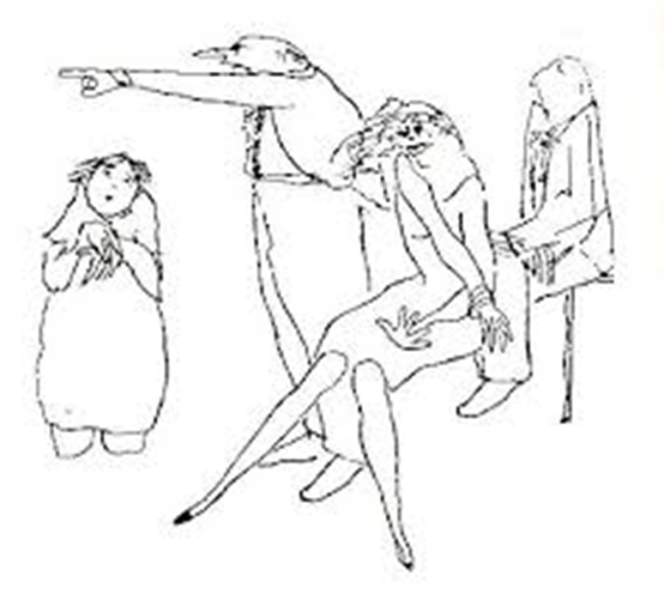
Coping Stances
BLAMER
PLACATER
SUPER REASONABLE
IRRELEVANT

Slide 7
Click on the image to book your place
Thank You
☺

